Slide 1
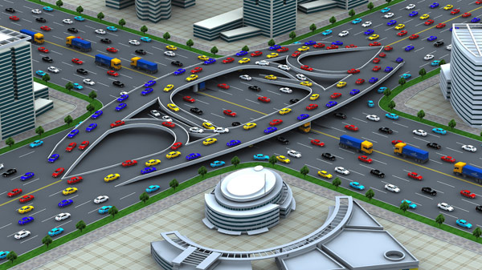
Traffic Engineering
University of Diyala
College of Engineering
Civil Engineering Department

Slide 2
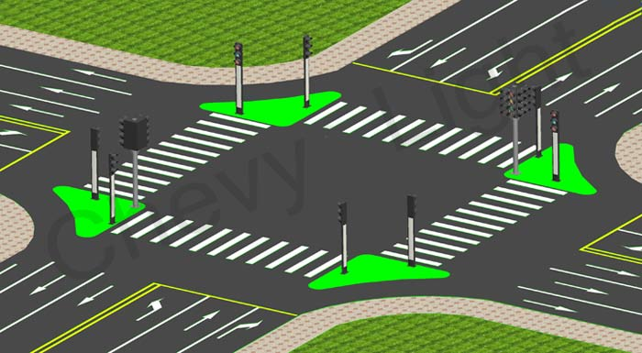
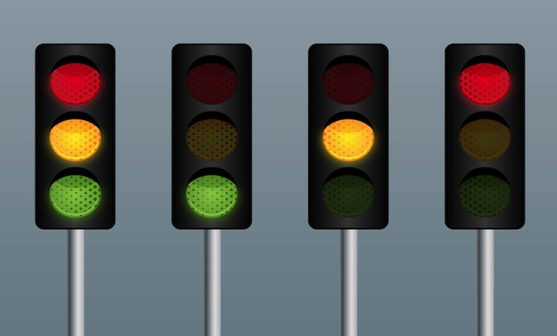
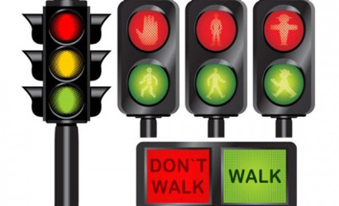
Traffic Signals Design

Slide 3
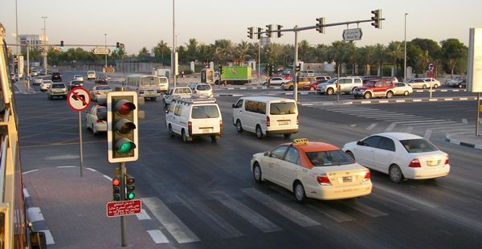
Advantages
Increase the capacity
Provides ordinarily movement of traffic
Reduce the accident
Replace traffic police
Disadvantages
Rear and type conflict can increase
Vehicles are delayed
Power failure

Slide 4
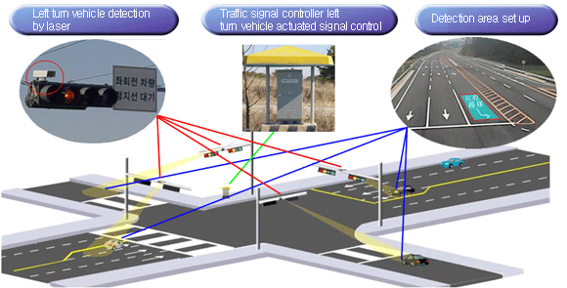
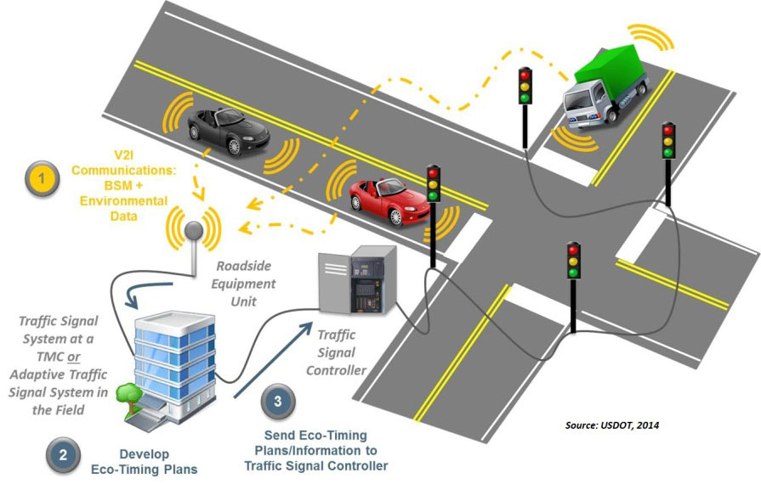
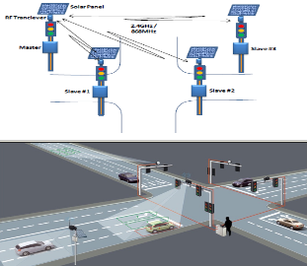
Types of Signals Design
vehicle actuated traffic signals

Slide 5
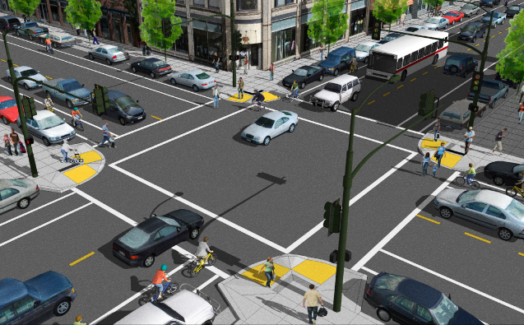
Types of Signals Design
Fixed time traffic signals

Slide 6
Design Procedure Steps
Phase design,
Determination of intervals time,
Determination of cycle time,
Apportioning of green time,
Pedestrian crossing requirements,
The performance evaluation of the above design.

Slide 7
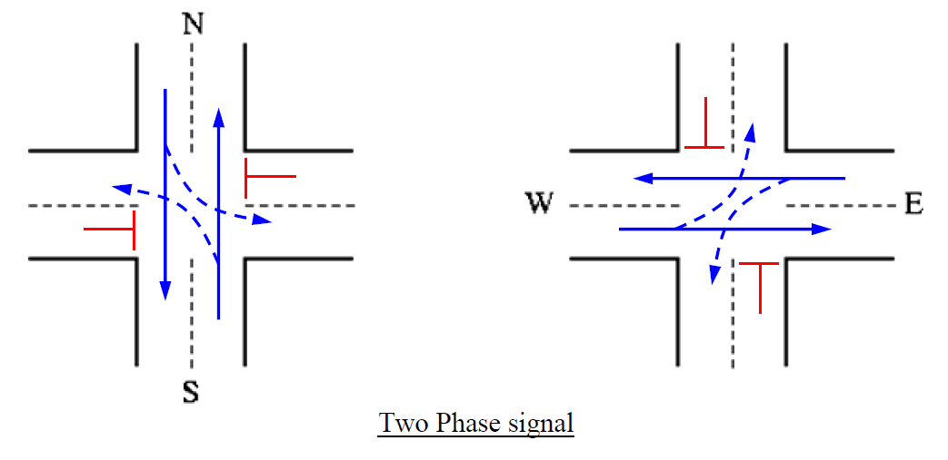
Phase Design
Its to separate the conflicting movements into various phases.
If all the movements are to be separated with no conflicts, then a large number of phases are required.

Slide 8
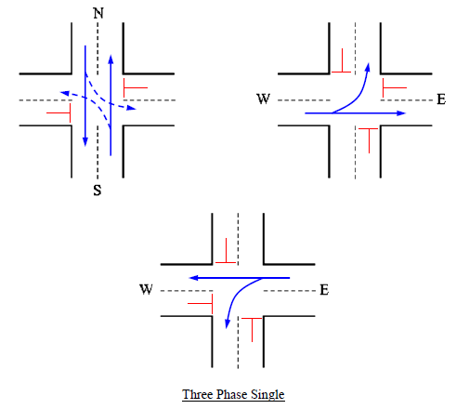
Phase Design

Slide 9
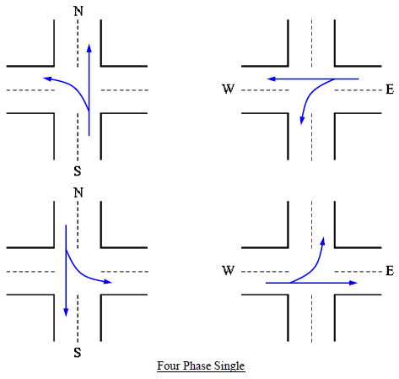
Phase Design

Slide 10
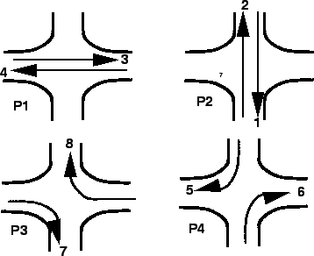
Phase Design

Slide 11
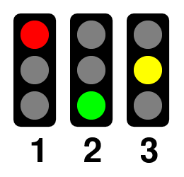
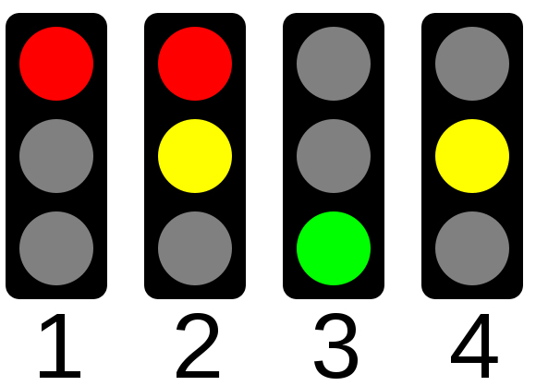
Intervals Time
Sort of traffic signals are in Iraq is
(Red – Green – Amber)
( Red – Red/Amber – Green – Amber)
Amber = 3 second
Red/Amber (all read)= 2 second

Slide 12
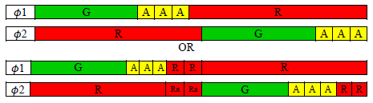
Intervals Time
The change interval or yellow time (Amber)
It is provided after green time for movement. The purpose is to warn a driver approaching the intersection during the end of a green time about the coming of a red signal.

Slide 13
Intervals Time
The clearance interval (Red/Amber)
It is provided after yellow interval, it is used to clear off the vehicles in the intersection. Clearance interval is optional in a signal design. It depends on the geometry of the intersection. If the intersection is small, then there is no need of clearance interval whereas for very large intersections, it may be provided.

Slide 14
Intervals Time
Intergreen Period (Ig)
It is the period between the end of green on one phase and start of green on next phase,
the minimum intergreen = 4 second.

Slide 15
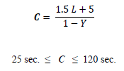
Optimum Cycle Time
Cycle time is the time taken by a signal to complete one full cycle of iterations.
The Webster is following to calculate the length of cycle time.
C : Optimum cycle time (sec)
L : Total lost time per cycle (sec)
Y : = ∑yi : the sum. Of critical flow ratio
y= Approach flow (V) / Saturation flow (S)

Slide 16
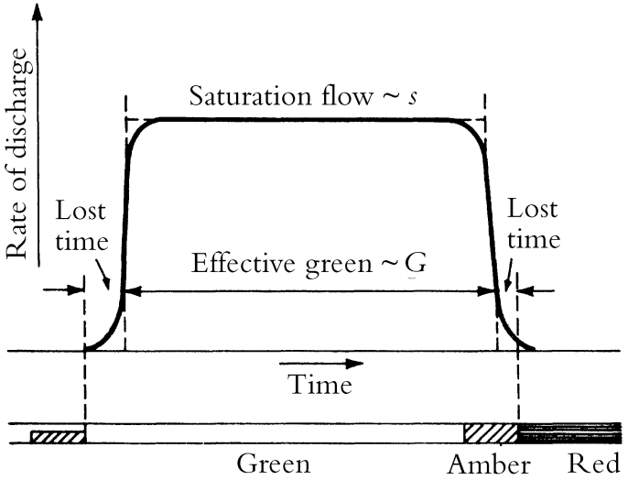
Lost Time (L)
Total lost time (sec) = lost time during the green + lost time during the intergreen period
L = No. of phases (starting delay + all red time)

Slide 17
Saturation Flow (S)
Generally measured in equivalent passenger cars that can cross the stop line of the approach, where is a continuous green signal indication and a continuous queue of vehicles on the approach (pcu/hr).
Saturation Flow (S) = 525 x W
5.5 m ≤ W ≤ 18m
W (m) | 3.0 | 3.5 | 4.0 | 4.5 | 5.0 | 5.5
S (pcu/hr) | 1850 | 1875 | 1975 | 2175 | 2550 | 2900

Slide 18
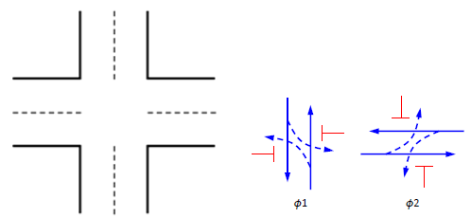
Example -1
Determine the critical flow ratio for four-legs intersection with two phases?
70 680 60
W 12 m
80 800 40
W 10 m
W 9 m
50 500 60
60 660 60

Slide 19

Green Time
Total Effective Green Time = Get = C -L
Effective Green Time =
Actual Green Time = GA = GE + St - A

Slide 20

Delay at Traffic Signals
d: delay (sec)
C: cycle time (sec)
GA: actual green time (sec)
q: flow (veh/hr)
S: Saturation flow (veh/hr)
For change the S pcu/hr to S veh/hr. by dividing S pcu/hr on pcu factor.
For change the q pcu/hr to q veh/hr. by dividing q pcu/hr on pcu factor or directly from the field counting.
The pcu factor will be the overall pcu volume divided by the overall volume (veh/hr) = (1.10 – 1.35).

Slide 21
Example -2
Design hour traffic flows at a four-leg, three-phase intersection are given in the table below. The intergreen period is 5 second, and starting delay is 2 second per green interval. Calculate the optimum cycle time, the actual green time, draw the cycle timing diagram of signals, and check the delay?
No. | Approach | Movement | Traffic Components |  |  |  | App. width(m)
 |  |  | Pass.Car | S.buse | Truck | Cycle
1 | NB | Th + RT | 500 | 100 | 10 | 20 | 7.5
2 | NB | LT | 50 | 10 | 0 | 10 | 7.5
3 | SB | Th + RT | 400 | 150 | 0 | 30 | 7.5
4 | SB | LT | 40 | 30 | 0 | 5 | 7.5
5 | WB | Th + RT | 400 | 50 | 5 | 10 | 3.5
6 | WB | LT | 300 | 60 | 0 | 20 | 3.5
7 | EB | Th + RT | 200 | 180 | 4 | 16 | 3.5
8 | EB | LT | 260 | 20 | 0 | 10 | 3.5

Slide 28


